Slide 1
Prometheus AlertManager and Long-term Storage
Lee Calcote

Slide 2

Hello

Slide 3

Show of Hands

Slide 4
Prometheus AlertManager

Slide 5
Prometheus Alertmanager
PURPOSE
AlertManager is an alert…
Ingester
Grouper
De-duplicator
Silencer
Throttler
Notifier

Slide 6
\ˈnō-mən-ˌklā-chər
A brief Prometheus AlertManager construct review
ROUTES
RECEIVERS
Match alerts to their receiver and how often to notify
Where and how to send alerts

Slide 7
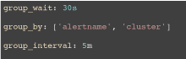
\ˈnō-mən-ˌklā-chər
A brief Prometheus Alertmanager construct review
MUTING
SUPPRESSING
CORRELATING
Silencers – match alerts with specific labels and prevent them from being included in notifications
Inhibitors – suppress specific notifications when other specific alerts are already firing
Grouping – categorize alerts of similar nature into a single notification

Slide 8
Multiple approaches to suppression
vs
vs
SILENCES
Via ui/api
INHIBITION
global
REPEAT_INTERVAL
Per route

Slide 9
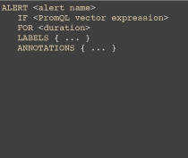
Alerts a shared construct
PROMETHEUS
STATE TRANSITION
ALERTMANAGER
Is notified when alerts transition state
inactive
pending
inactive
notifications
firing
firing
Supports clients other than Prometheus

Slide 10







Notification Integrations

Slide 11
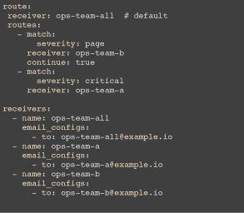
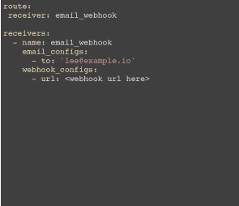
Notifying to Multiple Destinations
Use continue to advance to next receiver.
Use a receiver that goes to both destinations.
OR

Slide 12
Non-HA Alertmanager Architecture
subscribe
alerts
Alert Provider
Dispatcher
Notify Provider
store
Batched alerts
Dispatcher sorts incoming alerts into aggregation groups and assigns the correct notifiers to each.
Checks for previously sent notifications
apl
Silence Provider
De-duplication
Retry
Notification pipeline
Inhibitor
Silencer
UI
Maintenance Script
De-duplication
Retry

Slide 13
High Availability (HA)
Being introduced in 0.5 built atop Weave Mesh
With HA, you no longer have to monitor the monitor.
Designed for an alert to be sent to all instances in the cluster.
All Prometheus instances send alerts to all Alertmanager instances.
Guarantees notifications to be sent at least once.

Slide 14
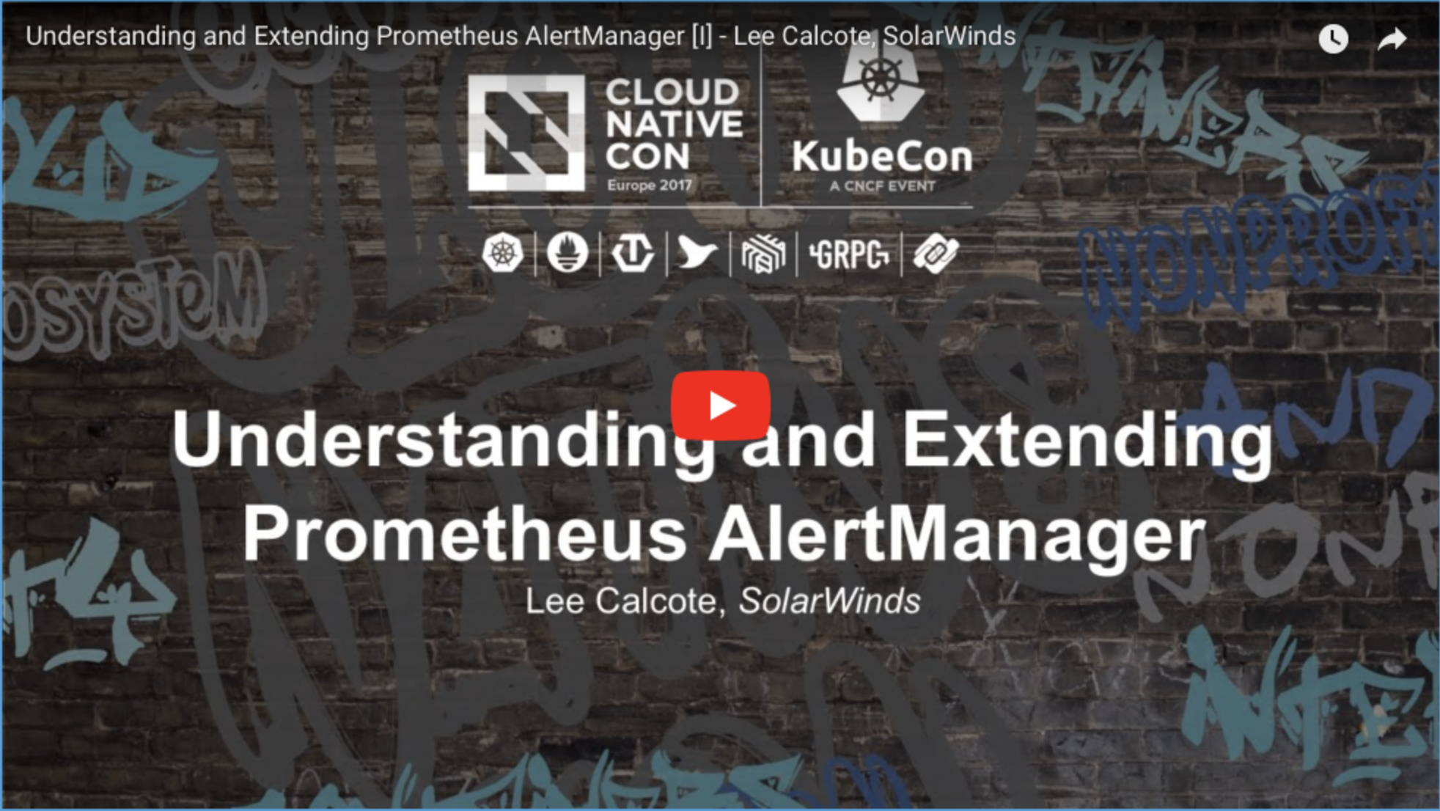
Understanding and Extending Prometheus AlertManager
KubeCon EU 2017

Slide 15
Prometheus Storage Adapters

Slide 16
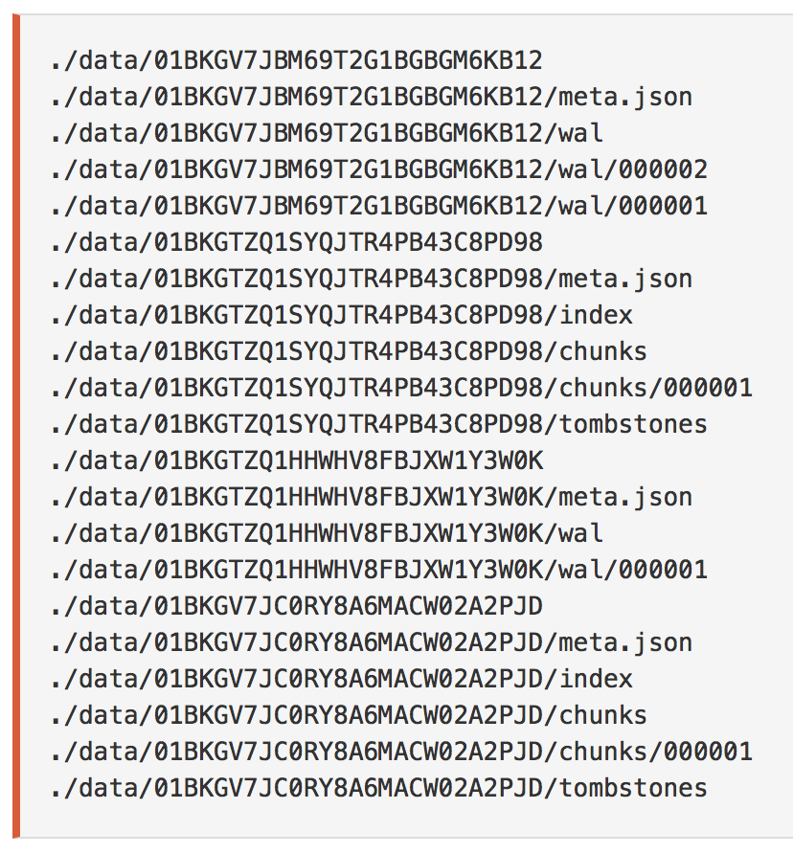
Prometheus Local Storage
“An ephemeral sliding window of recent data”
Prometheus stores sample data on disk in a highly optimized custom format based on flat files.
Efficient
Tunable
NOT scalable
NOT durable
source: prometheus.io

Slide 17

Prometheus Remote Storage
The solution is a remote storage adapter.
Write samples
Custom protocol
Adapter
Prometheus
Request: matchers + time ranges
Receive: series + samples
Adapter: an application that can receive batches of samples from Prometheus over HTTP and send them to some back end.
Third-Party Storage

Slide 18

AppOptics Remote Storage Adapter
Send Prometheus data to AppOptics
POST/receive
POST/v1/measurements
prometheus2appoptics
1000 Samples per POST
Prometheus
Batching
Translation

Slide 19
AppOptics Prometheus Storage Integration

Slide 20




Resources
#
IRC: #prometheus on irc.freenode.net
Mailing lists:
Prometheus-users – discussing Prometheus usage and community support
Prometheus-developers – contributing to Prometheus development
@PrometheusIO
Prometheus repositories to file bugs and feature requests
github.com/solarwinds/prometheus2appoptics
hub.docker.com/r/solarwinds/prometheus2appoptics

Slide 21

Thank you!
We’re hiring.

